Slide 1
HI! NICE TO MEET YOU!!

Slide 2
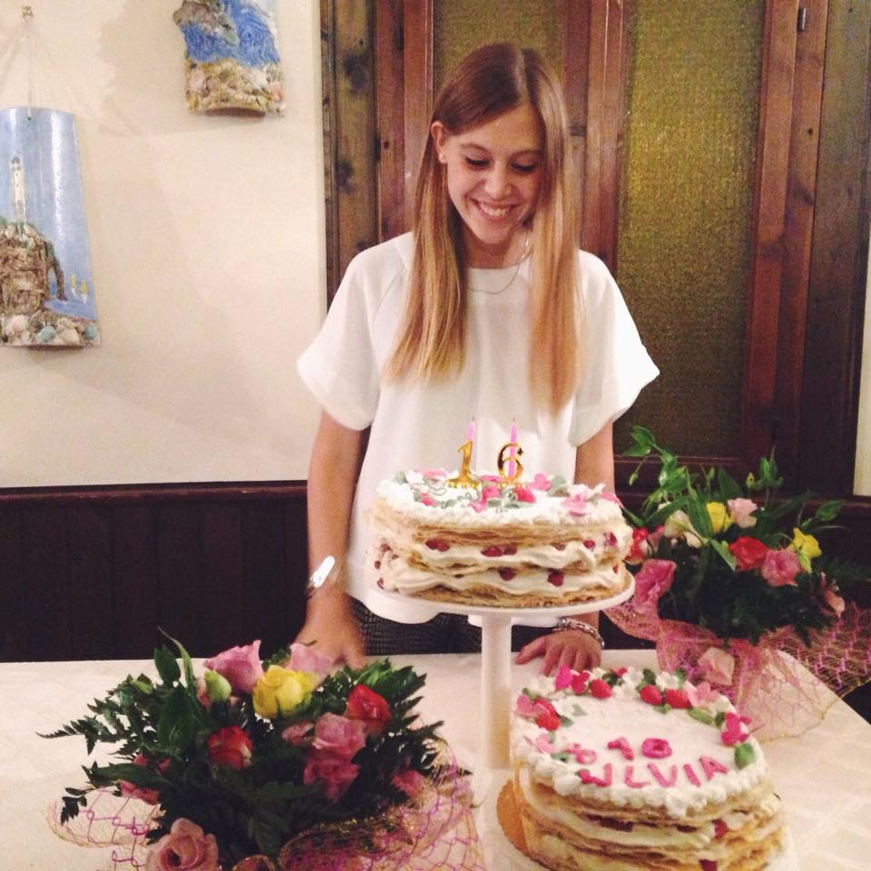
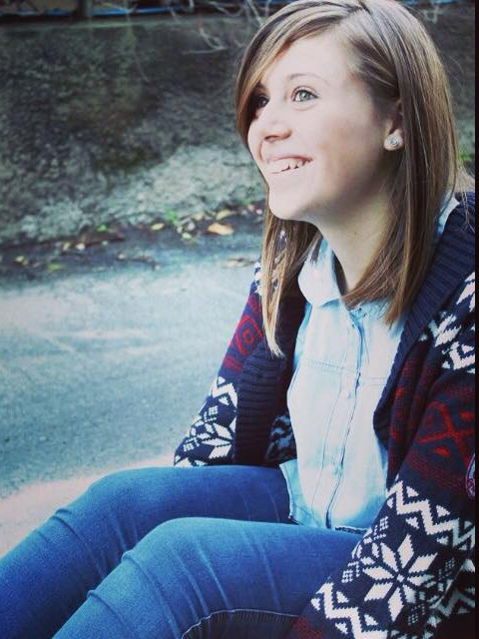
MY NAME IS SILVIA I AM 16 YEARS OLD I’M AN ITALIAN GIRL AND I AM A CLASSIC HIGH SCHOOL STUDENT IN BELVEDERE MARITTIMO. I LIKE DANCING AND EATING PIZZA. I HAVE GOT A BROTHER.

Slide 3
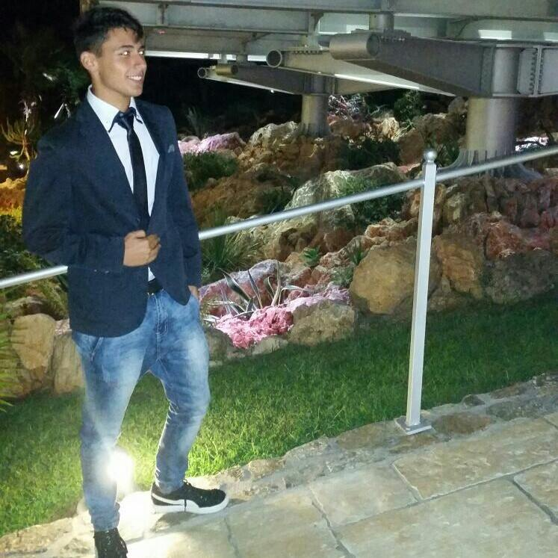
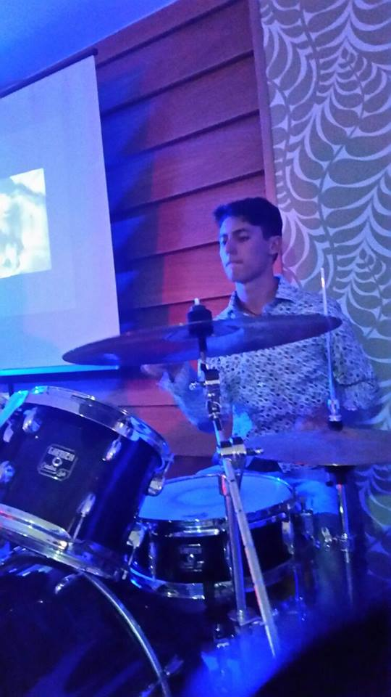
MY NAME IS MASSIMILIANO I AM 16 YEARS OLD I’M AN ITALIAN BOY AND I AM A SCIENTIFIC HIGH SCHOOL STUDENT IN BELVEDERE MARITTIMO. I LIKE PLAYING DRUMS I HAVE GOT A SISTER.

Slide 4
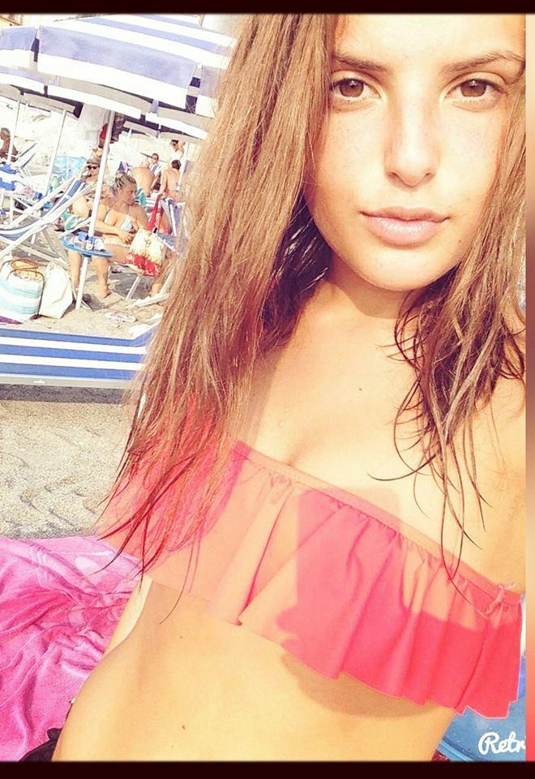
MY NAME IS CLARA I AM 16 YEARS OLD I’M AN ITALIAN GIRL AND I AM A SCIENTIFIC HIGH SCHOOL STUDENT IN BELVEDERE MARITTIMO. I LIKE DANCING AND EATING PIZZA. I HAVE GOT A BROTHER

Slide 5
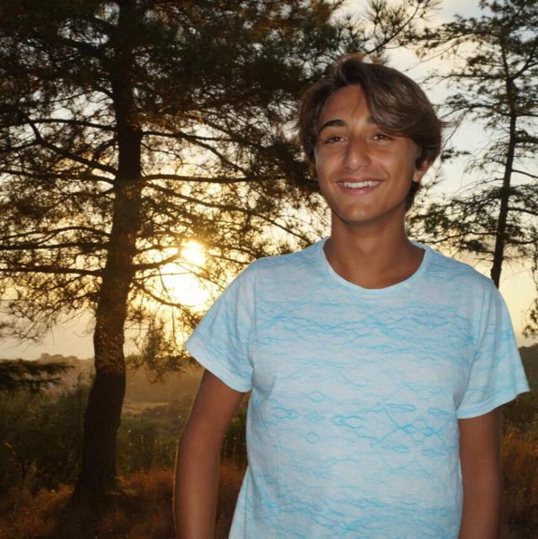
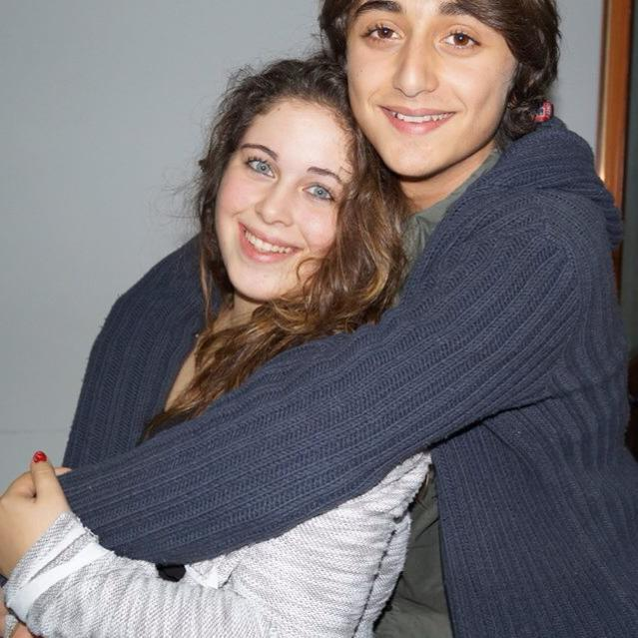
MY NAME IS ANDREA I AM 15 YEARS OLD I’M AN ITALIAN BOY AND I AM A SCIENTIFIC HIGH SCHOOL STUDENT IN BELVEDERE MARITTIMO. I LIKE PLAYING VOLLEYBALL. I HAVE GOT A SISTER.

Slide 6
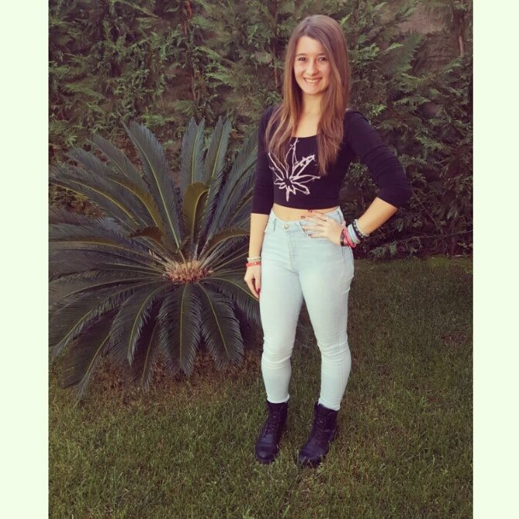
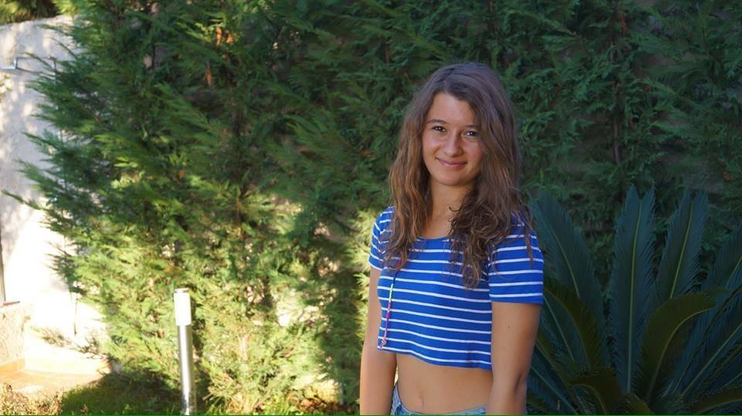
MY NAME IS DENISE I AM 16 YEARS OLD I’M AN ITALIAN GIRL AND I AM A SCIENTIFIC HIGH SCHOOL STUDENT IN BELVEDERE MARITTIMO. I LIKE DANCING. I HAVE GOT A BROTHER.

Slide 7
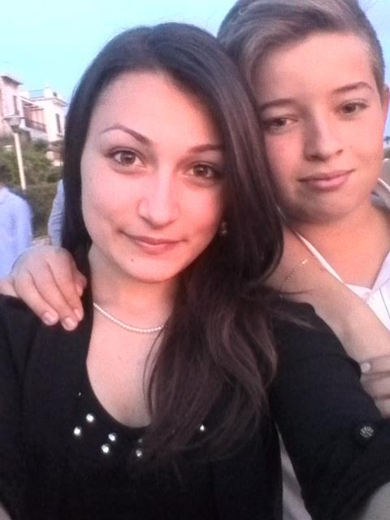
MY NAME IS LUCA I AM 16 YEARS OLD I’M AN ITALIAN BOY AND I AM A SCIENTIFIC HIGH SCHOOL STUDENT IN BELVEDERE MARITTIMO. I LIKE PLAYING FOOTBALL. I HAVE GOT TWO BROTHERS.

Slide 8
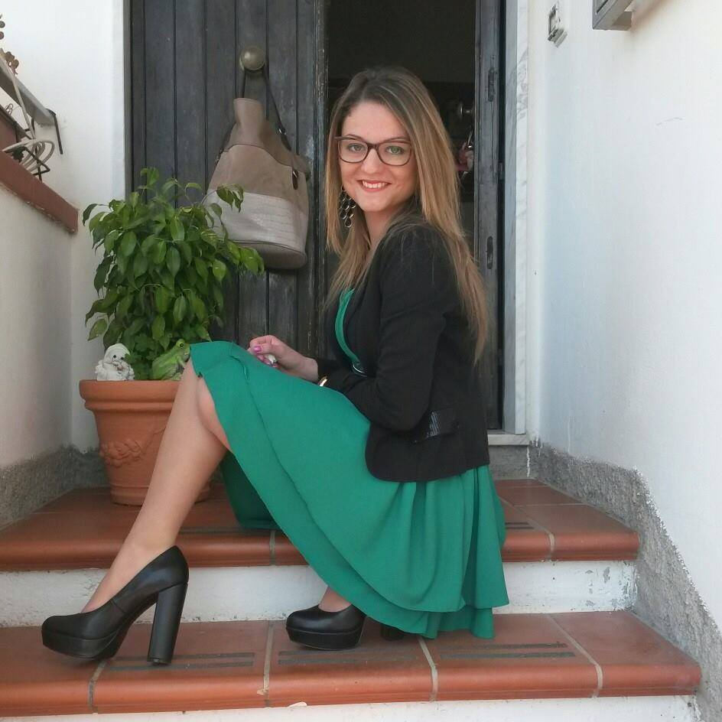
MY NAME IS ANNARITA I AM 17 YEARS OLD I’M AN ITALIAN GIRL AND I AM A LINGUISTIC HIGH SCHOOL STUDENT IN BELVEDERE MARITTIMO. I LIKE SINGING. I HAVE GOT A SISTER.

Slide 9
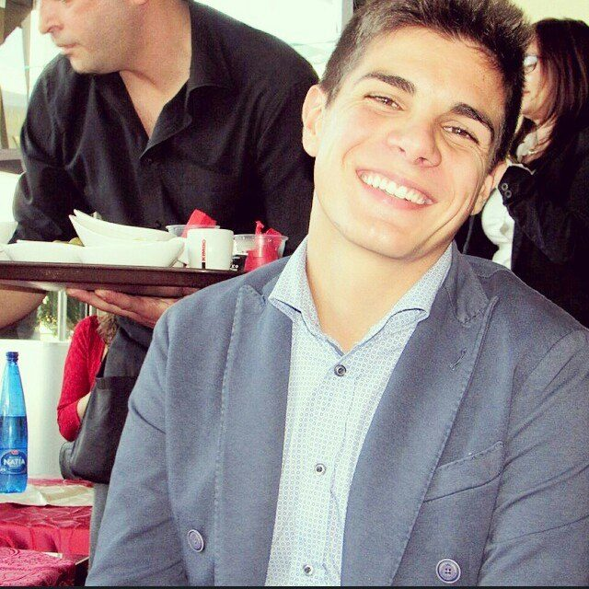
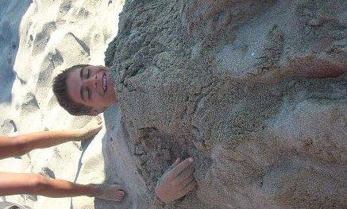
MY NAME IS VINCENZO I AM 17 YEARS OLD I’M AN ITALIAN BOY AND I AM A SCIENTIFIC HIGH SCHOOL STUDENT AT THE HIGH SCHOOL IN BELVEDERE MARITTIMO. I LIKE PLAYING FOOTBALL. I HAVE GOT TWO SISTERS.

Slide 10
MY NAME IS DENISE I AM 16 YEARS OLD I’M AN ITALIAN GIRL AND I AM A LINGUISTIC HIGH SCHOOL STUDENT IN BELVEDERE MARITTIMO. I LIKE DANCING AND LISTENING TO THE MUSIC. I HAVE GOT TWO SISTERS.

Slide 11
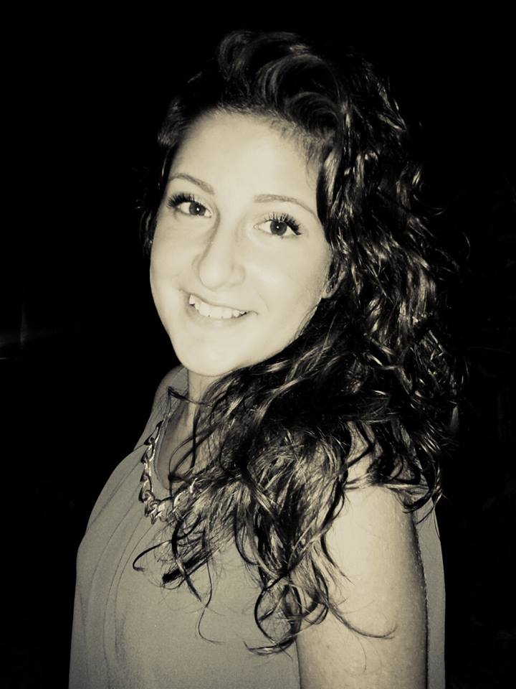
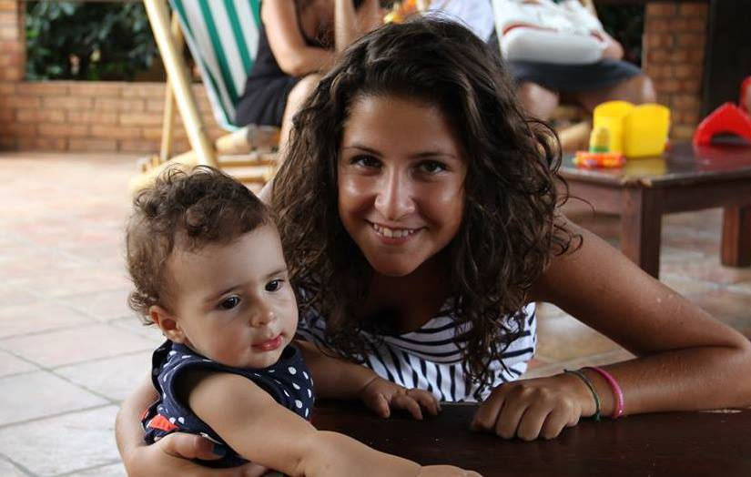
MY NAME IS FEDERICA I AM 16 YEARS OLD I’M AN ITALIAN GIRL AND I AM A LINGUISTIC HIGH SCHOOL STUDENT IN BELVEDERE MARITTIMO. I LIKE LISTENING TO THE MUSIC. I HAVE GOT TWO SISTERS.

